Slide 1
Entity Framework

Slide 2
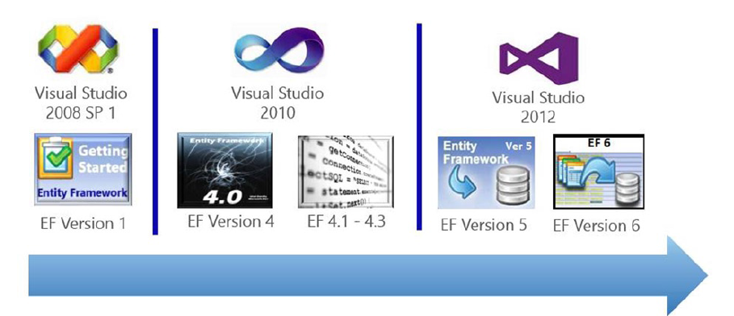
Uvod
Entity Framework je ORM (Object Relational Mapper) i Microsoftov preporučeni način pristupa bazi
Povijest po verzijama
V1 - .NET Framework 3.5 SP1 (Visual Studio 2008)
V4 - .NET Framework 4.0
**V4.1** - uveden „Code-First” (Visual Studio 2010-2012)

Slide 3
Početak
Entity Framework 1
Inicijalni release
Design-first (Database First)
Podrška sa EF Designer and Tools za Visual Studio 2008 (sa SP1)
ObjectContext
Izazovi sa performansama

Slide 4

EF Code First - Revolucija
Entity Framework 4
Uvođenje “code first” pristupa
DbContext umjesto ObjectContext
Performance poboljšanja (pogotovo SQL Server provider)
POCO entity generator, T4 templates
Detached entities

Slide 5

EF 5
Entity Framework 5 EF5 je dostupan kao NuGet paket
Enum podrška
Table-valued functions for Database First.
Spatial data types
A number of performance enhancements

Slide 6
EF Code First Migrations
Pandan Database projektu, ali isključivo kroz modele i veze
Upravljanje verzijama sheme baze kroz kod i promjene na POCO objektima
Automated vs Manual migracije
Enable Migrations
Kreiranje inicijalne migracije i generiranje baze
Rad na modelima i vezama (mapiranja) dok nismo zadovoljni
Kreiranje migracije
Primjena na bazi (zadržati ili napraviti undo)

Slide 7
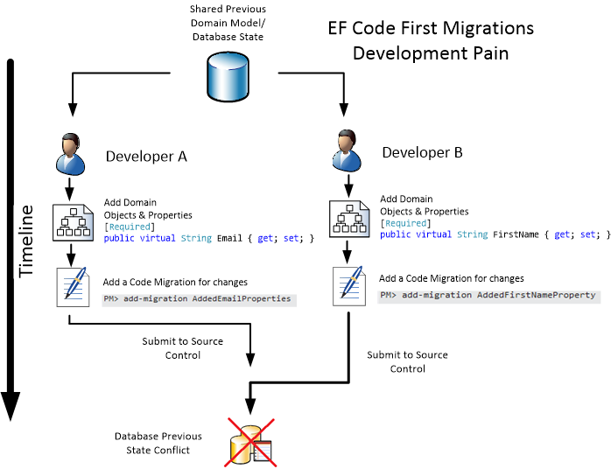
EF Code First Migracije

Slide 8

EF 6
Entity Framework 6
Async Query i Save
Custom Code First Conventions
Code First Mapping to Insert/Update/Delete Stored Procedures
Connection Resiliency
Dependency Resolution
Code-Based Configuration
Configurable Migrations History Table
Multiple Contexts per Database
Tooling Consolidation
Enums, Spatial and Better Performance on .NET 4.0

Slide 9
EF 6
Code First poboljšanja
Custom conventions
CUD (Create, Update, Delete) stored procedure mapping
Migrations history table customization
Multiple contexts per database
More performance improvements

Slide 10
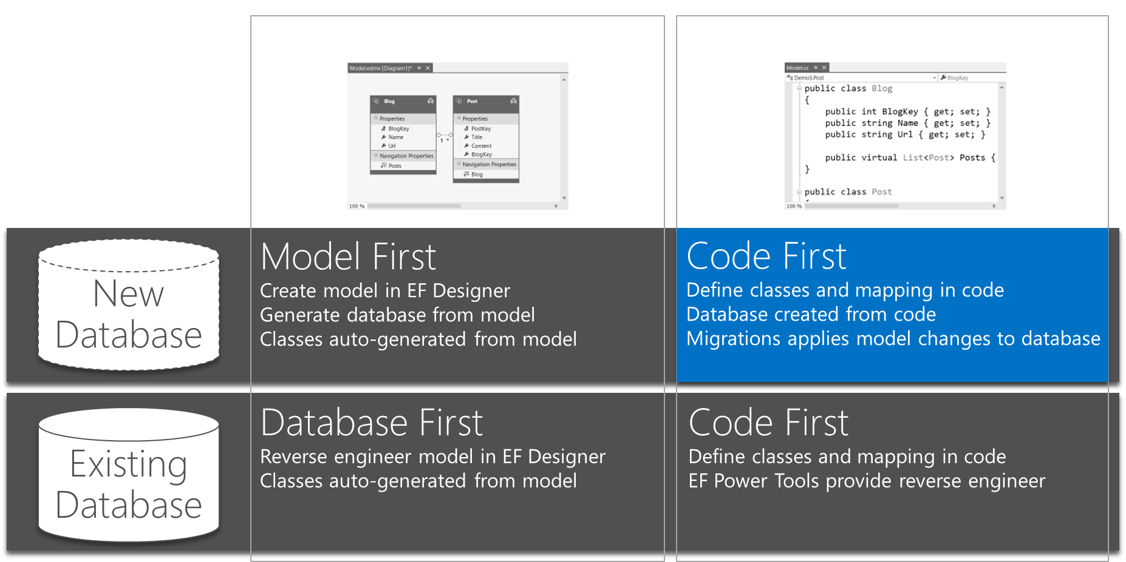
EF 6

Slide 11

EF 6
Async Query & Save
Što je?
Task based async pattern for query and save
Zašto?
Appropriate use of async can improve performance and scalability
Kada koristiti?
Reduce server resource usage by freeing up blocked threads
Improve client UI responsiveness by not blocking main thread
Parallelism – but not on the same context instance

Slide 12
EF 6 i dalje
Async Query & Save (EF6 onwards)
Async operations support
EF6 introduced support for asynchronous query and save using the async and await keywords that were introduced in .NET 4.5
it can be used to improve client responsiveness and server scalability when handling long-running, network or IO-bound tasks..

Slide 13
EF 6
Async Query & Save (EF6 onwards)
public static async Task PerformDatabaseOperations()
{
using (var db = new BloggingContext())
{
db.Blogs.Add(new Blog
{
Name = "Test Blog #" + (db.Blogs.Count() + 1)
});
await db.SaveChangesAsync();
var blogs = await (from b in db.Blogs
orderby b.Name
select b).ToListAsync();
foreach (var blog in blogs)
{
Console.WriteLine(" - " + blog.Name);
}
}
}

Slide 14
EF 6
Async Query static void Main(string[] args)
{
var task = PerformDatabaseOperations();
//task.Wait();
await task();
}

Slide 15
EF 5 vs EF 6

